Slide 1
Predicting Customer Satisfaction
Rachel Livingston
Senior Director, Operations
Zola

Slide 2
Project Proposal
Problem Statement:
Create a model to predict the customer satisfaction rating on incoming and in progress support tickets so they can be escalated in real time.
Business Case:
CSAT is a KPI on which my team is evaluated
Once a rating has been given, it can’t be changed
The only lever to raise your CSAT score is to get fewer bad ratings

Slide 3
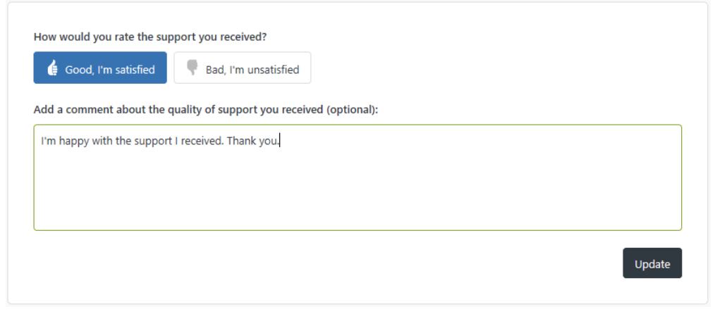
Definition of CSAT
CSAT is a measure of the number of positive responses to a simple question:
How would you rate the support you received?
Satisfaction Score = [Number of positive ratings]/[Total number of scores received]

Slide 4
EDA and Data Summary
Data Set:
24,552 rated support tickets
2019 calendar year
22 data attributes used*:
customer type
hour ticket created
agent wait time
assign time
first reply time
first resolution time
full resolution time
private comments
public comments
agent stations
reopens
replies
wrap up code (11 options)
Notes:
*While there are more interesting attributes I could use, these are the attributes that I can filter on it real time and action on tickets in real time.

Slide 5
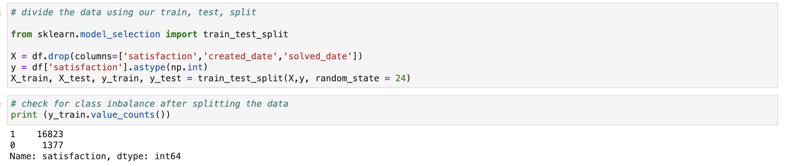
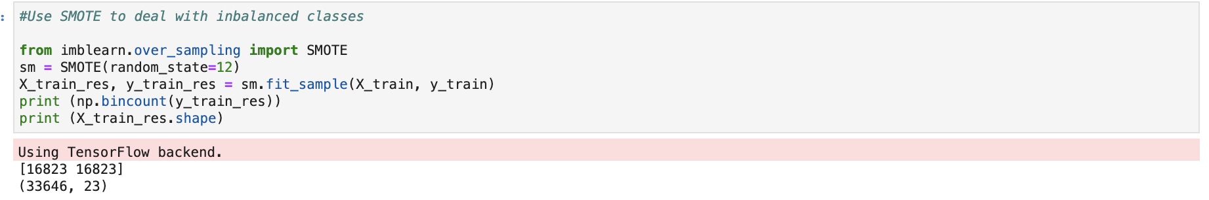
EDA and Cleaning Steps
Key cleaning steps:
Used SMOTE to deal with imbalanced classes

Slide 6
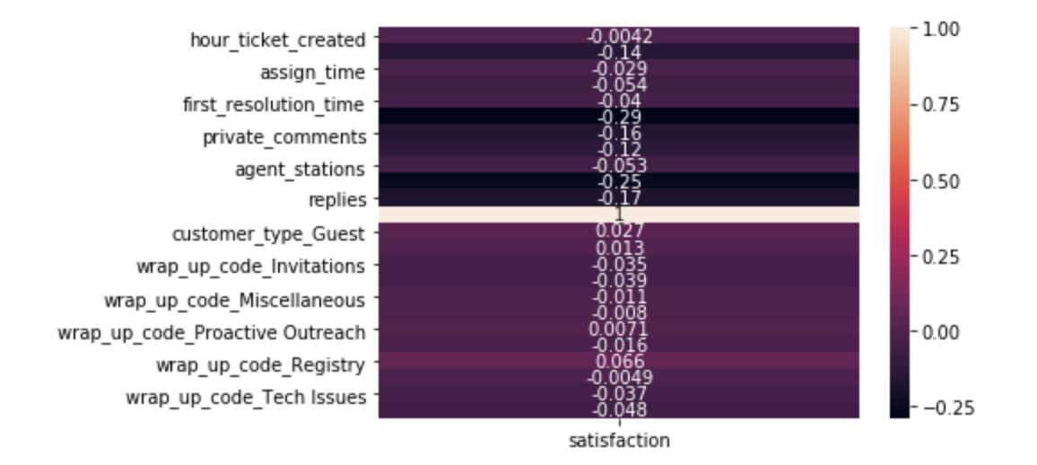
Correlation and Initial Hypothesis
Looked at correlation of all attributes to satisfaction
Six features appeared to have the largest impact
Notes:
1. agent_wait_time
2. full_resolution_time
3. private_comments
4. public_comments
5. reopens
6. replies

Slide 7
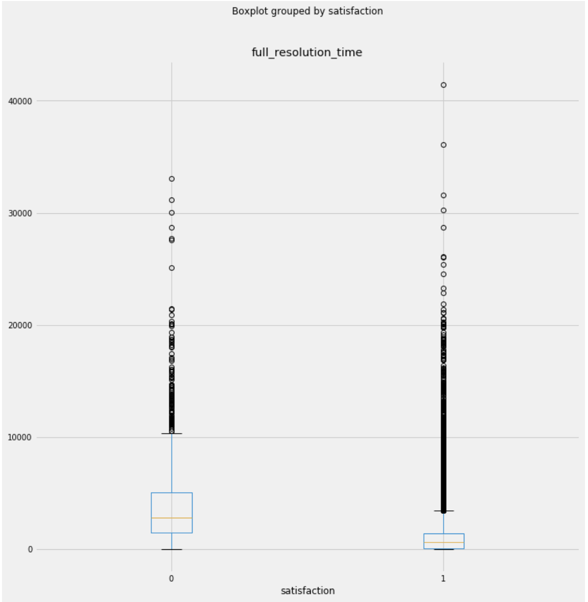
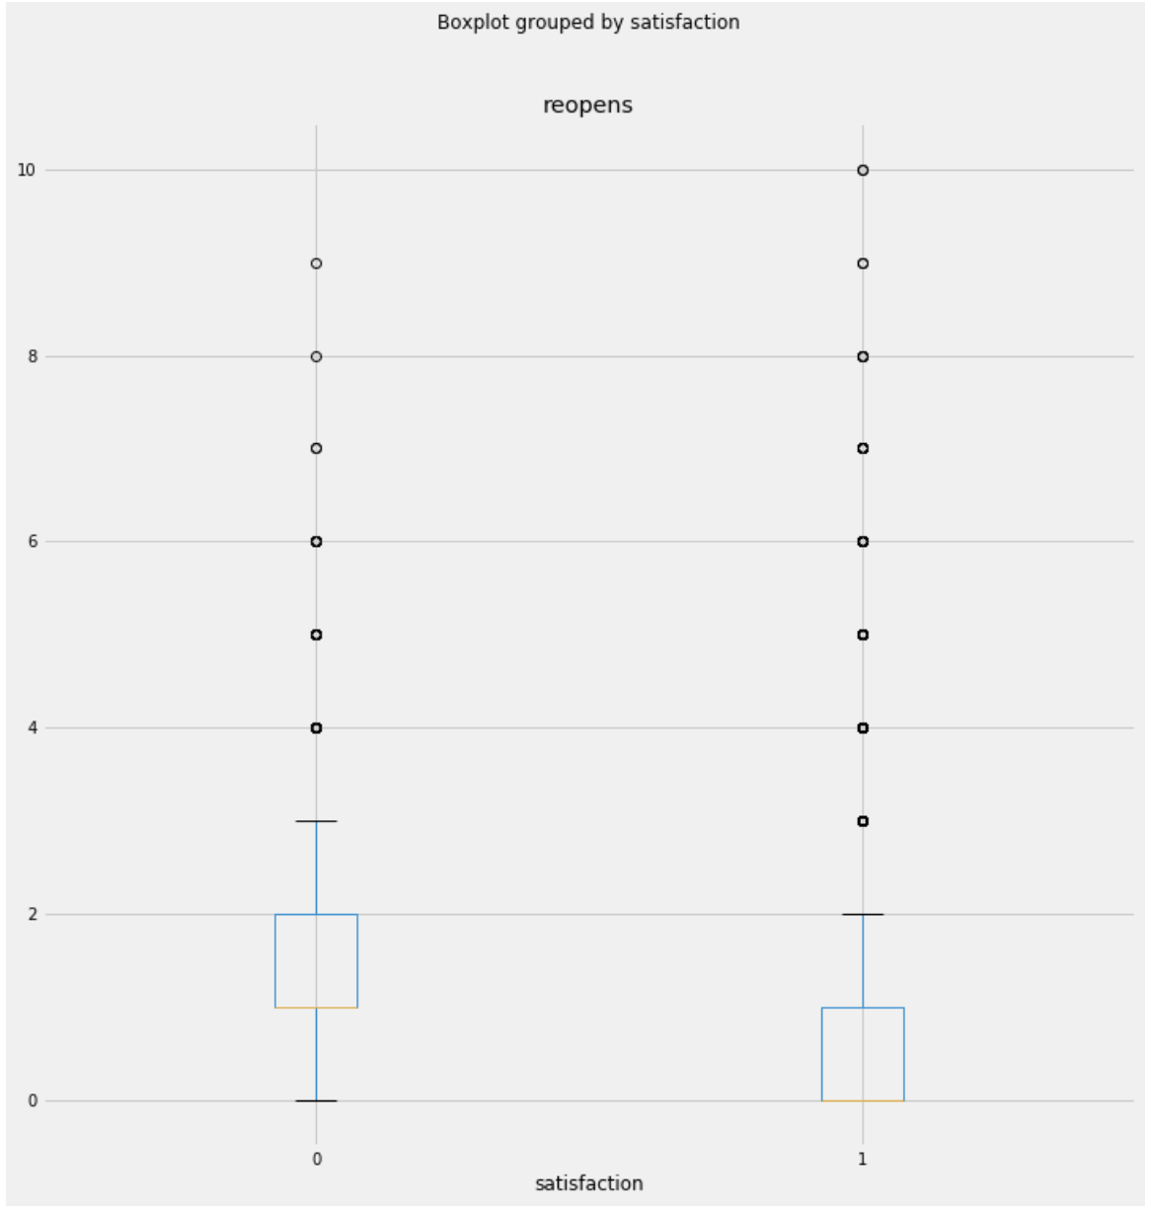
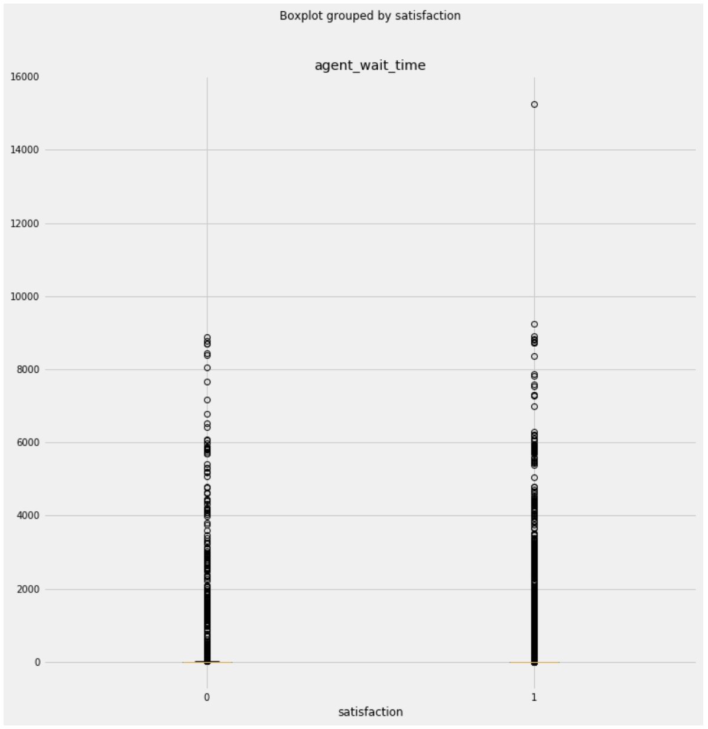
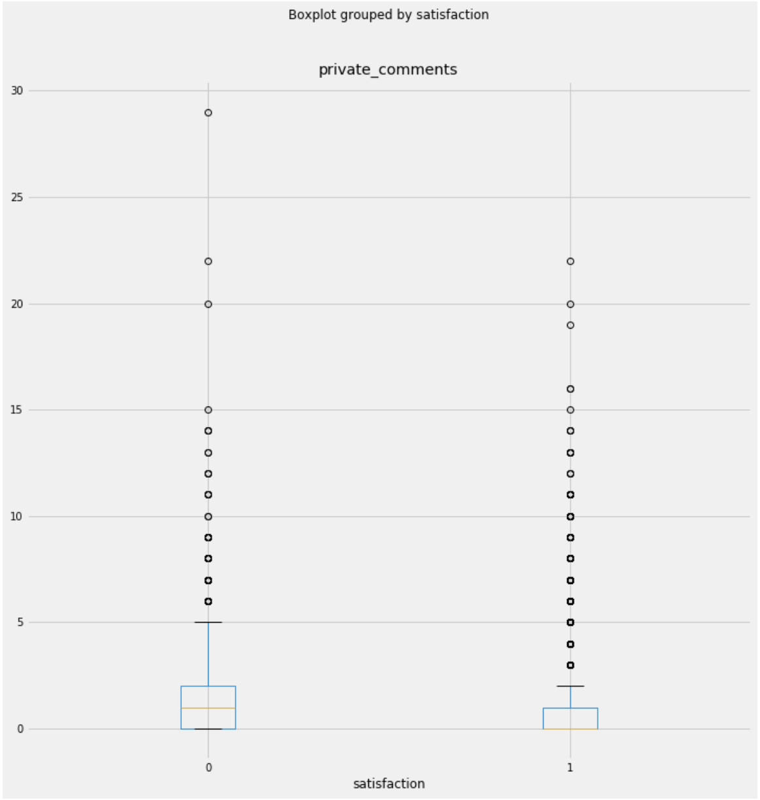
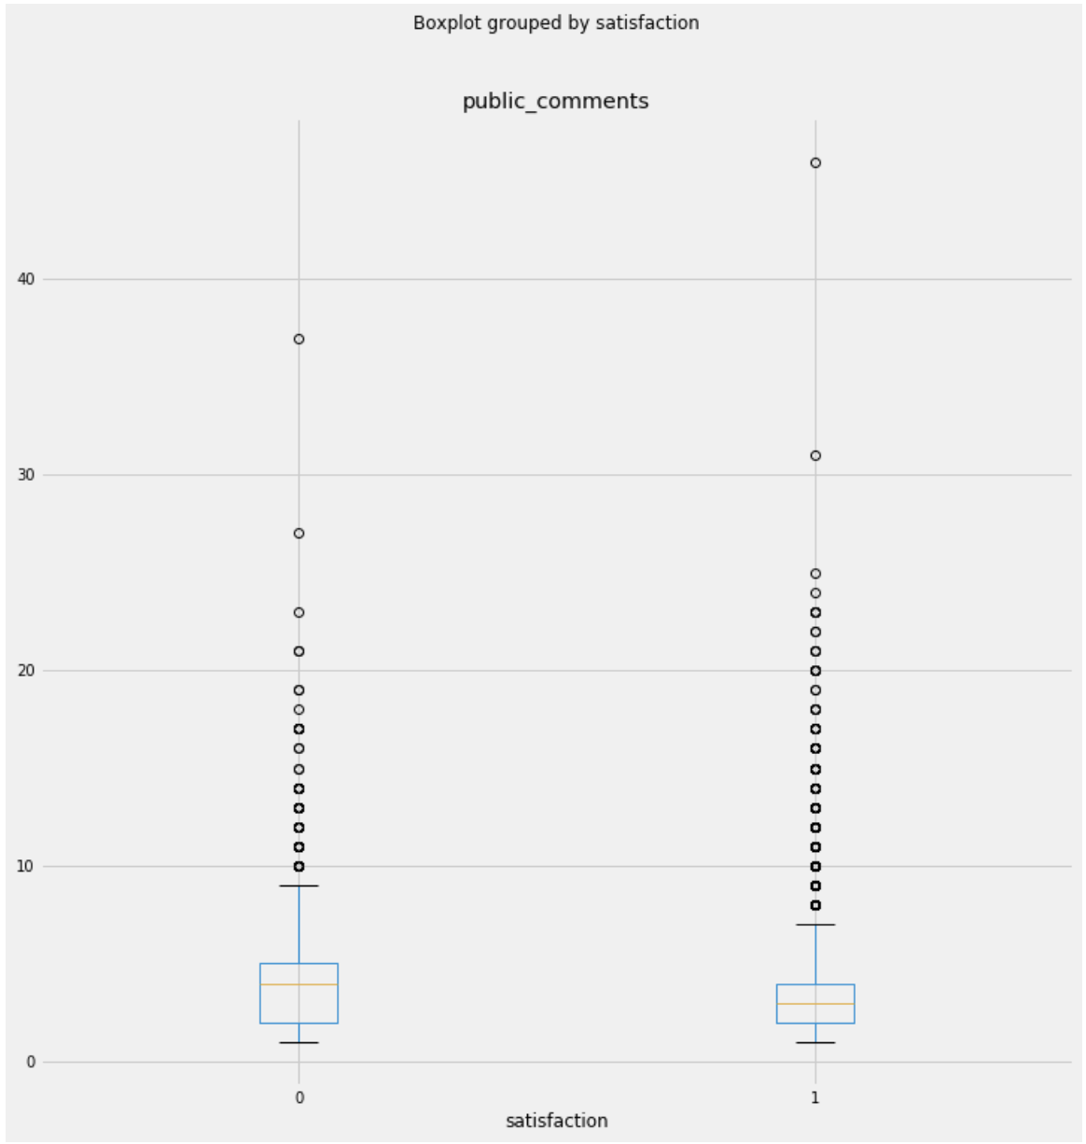
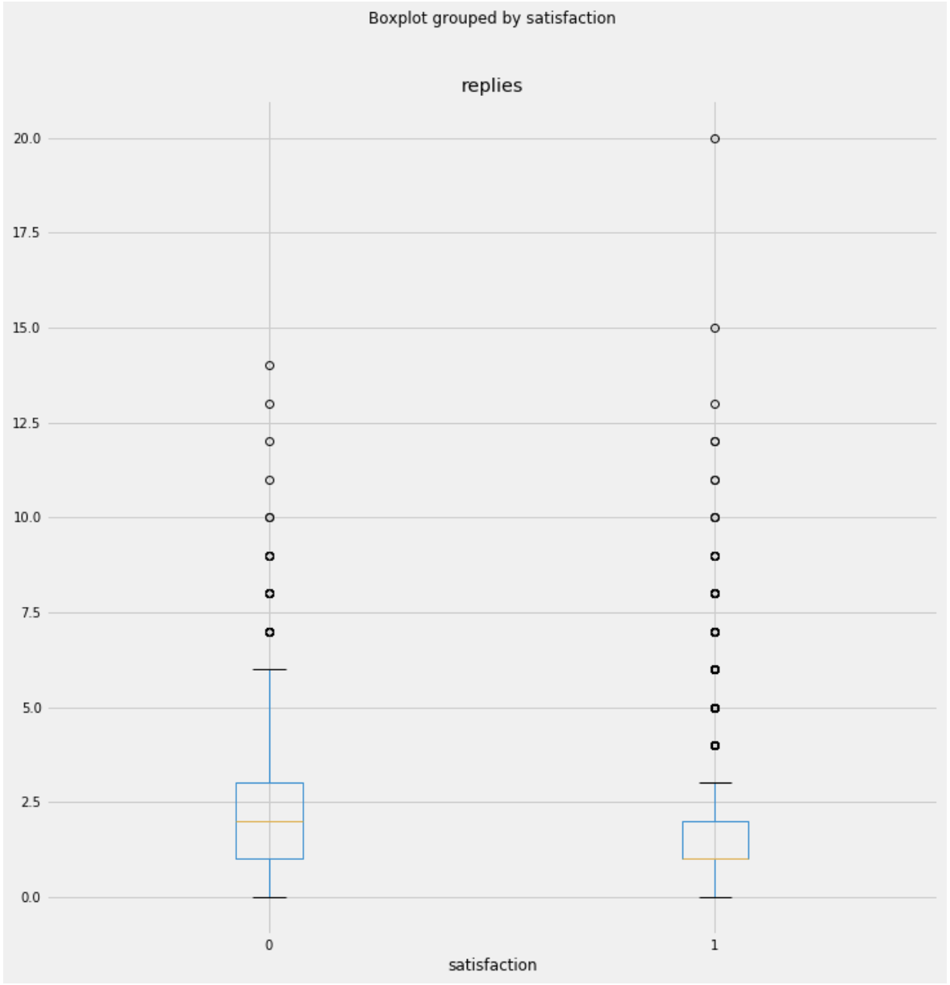
Top Feature Analysis

Slide 8
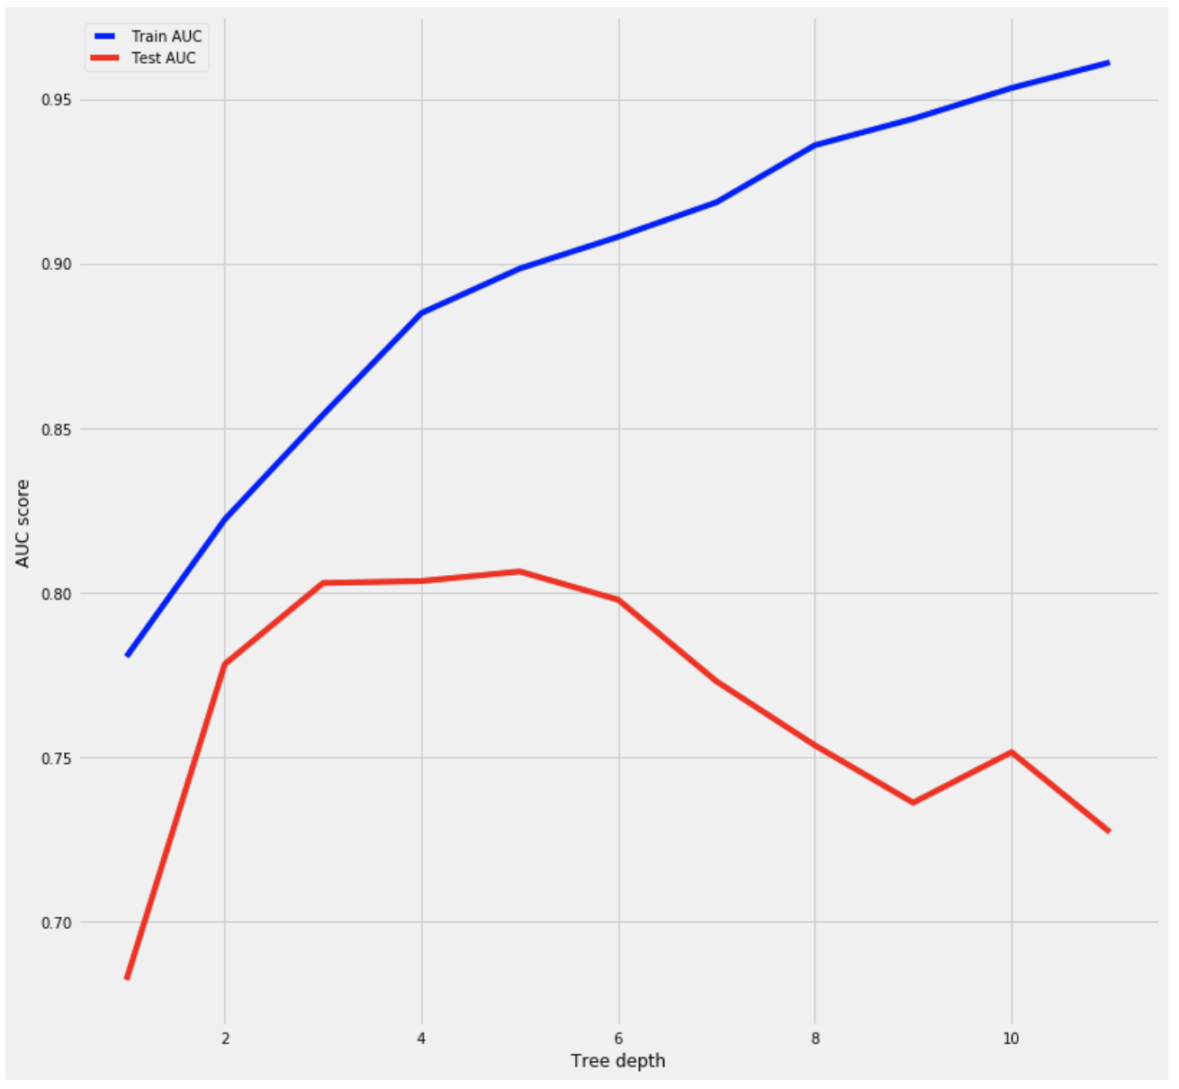
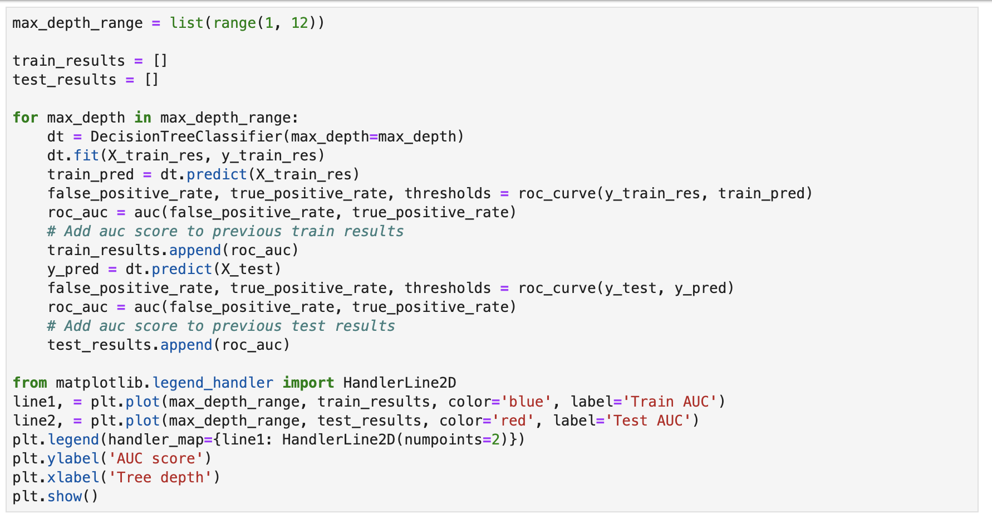
Feature Selection: Decision Tree
Optimized depth of tree using AUC score
Minimal different between 3 and 5 layers, picked 3

Slide 9
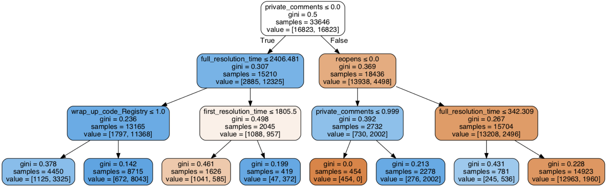
Feature Selection: Decision Tree
Highlighted node captured 77% of all bad tickets

Slide 10
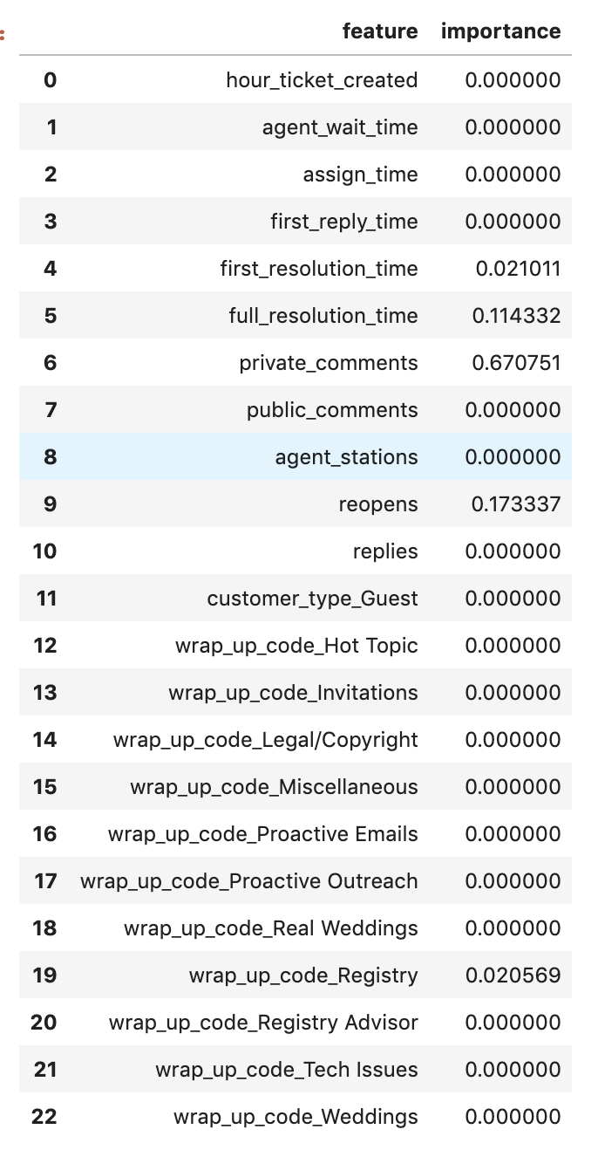
Gini importance of each feature
Most important features:
1. full resolution time
2. first resolution time
3. reopens
4. wrap up code is registry
5. the number of private comments

Slide 11
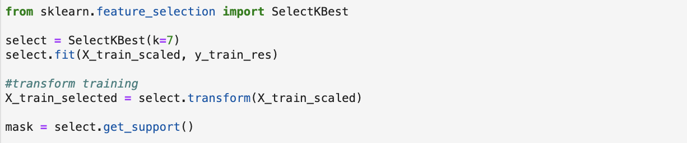
Feature Selection
K = 5
full_resolution_time
private_comments
public_comments
reopens
replies
K = 7
agent_wait_time
full_resolution_time
private_comments
public_comments
reopens
replies
wrap_up_code_Registry

Slide 12
Final Features
From the 2 lists, consolidate important features to:
agent wait time
full resolution time
first resolution time
reopens
wrap up code is registry
the number of private comments
the number of public comments

Slide 13
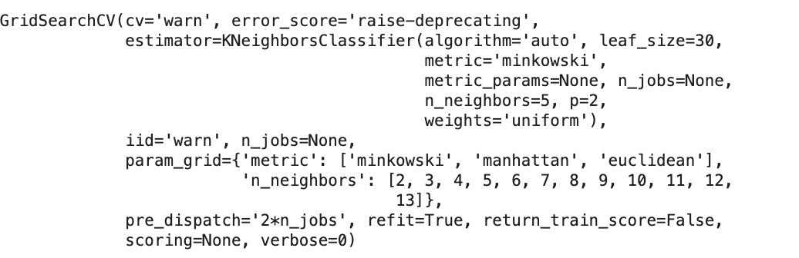
KNN Model
Grid Search Parameters:
n_neighbors: 2 – 14
metric: minkowski, manhattan, euclidean

Slide 14
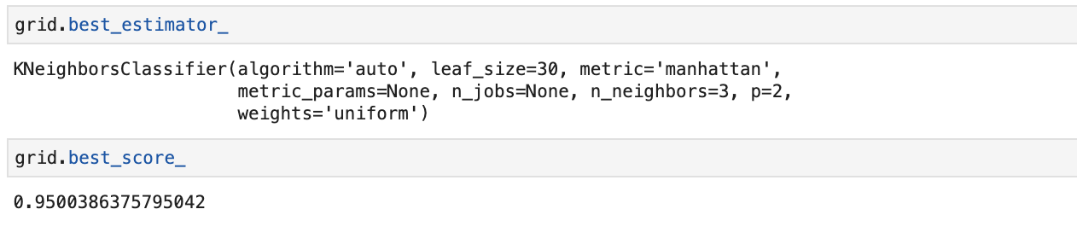
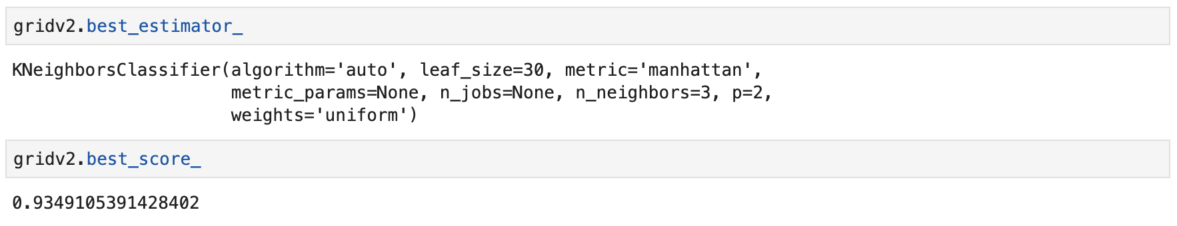
KNN Model Results
With all features:
With select features:

Slide 15
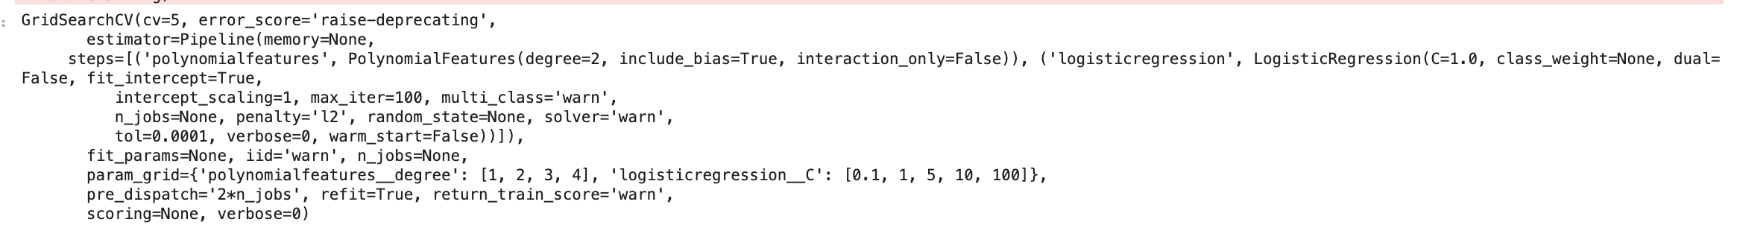
Logistic Regressor
Grid Search Parameters:
polynomial_features_degree: 1, 2, 3, 4
logisticregression__C: [0.1, 1, 5, 10, 100]

Slide 16
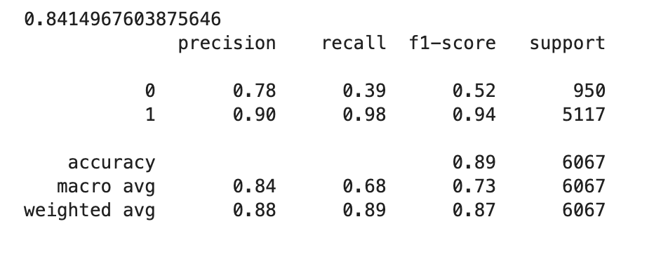
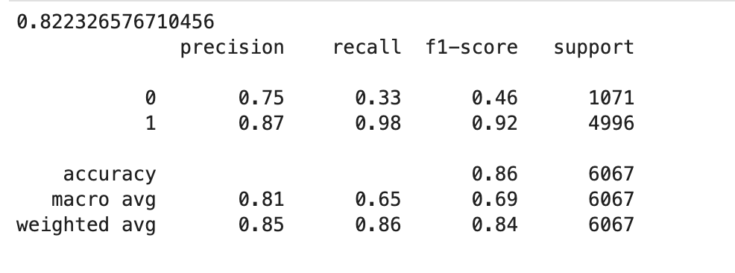
Logistic Regressor Results
With all features:
With select features:
Notes:
Accuracy was 82 and 84%
The model was much better about predicting the good tickets vs. predicting the bad tickets. The recall on predicting bad tickets wasn’t great.

Slide 17
Summary
Model performance:
KNN was the best model with accuracy of 93%
Decision tree most useful model in terms of practicality
Logisitic regressor was good at predicting ”good” tickets but not “bad” tickets
Feature Selection:
Tickets that take longer to solve in both time and conversation are more likely to be bad
These tickets are usually “hard” tickets

Slide 18
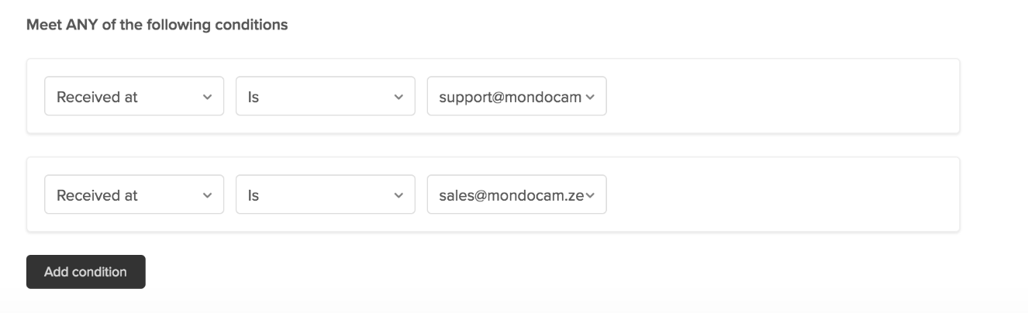
Next Steps
Create an automation with the following conditions:
Ticket is open longer than 6 hours
Ticket has been reopened
Ticket has a “private comment”
Tag tickets as “predicted bad”
Measure discrepancy between predicted bad and rated bad
Measure volume of predicted bad tickets

Slide 19
Questions?

